Slide 1
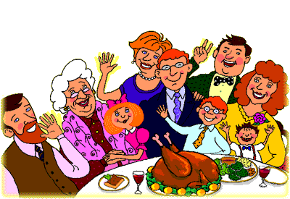
Family Day

Slide 2
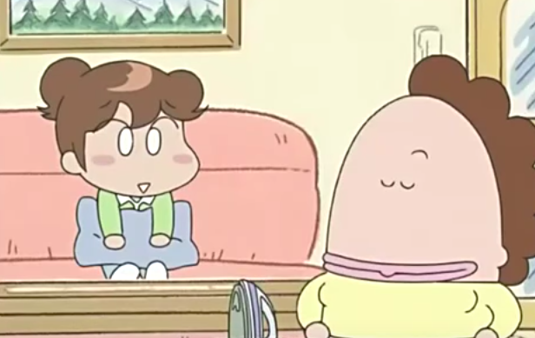
___ my _______.
She’s
mother

Slide 3
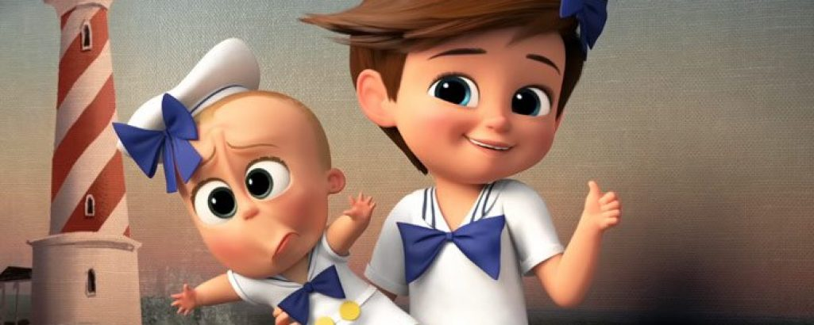
___ my _______.
He’s
brother

Slide 4
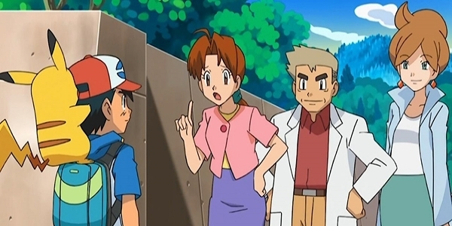
___ my _______.
She’s
mother

Slide 5
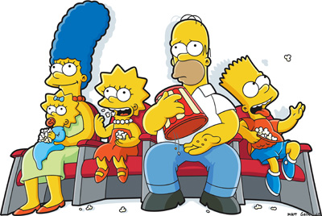
___ my _______.
He’s
father

Slide 6
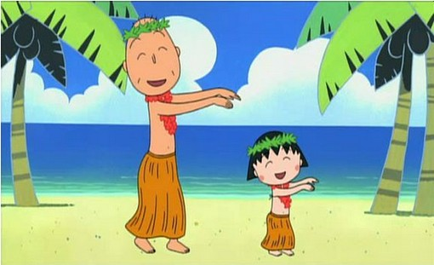
___ my _____.
He’s
grandpa

Slide 7
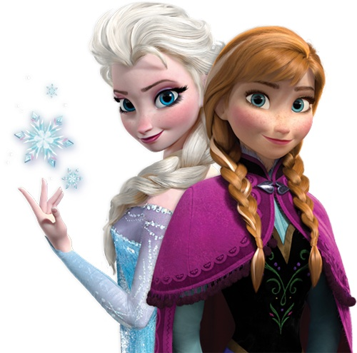
___ my _______.
She’s
sister

Slide 8
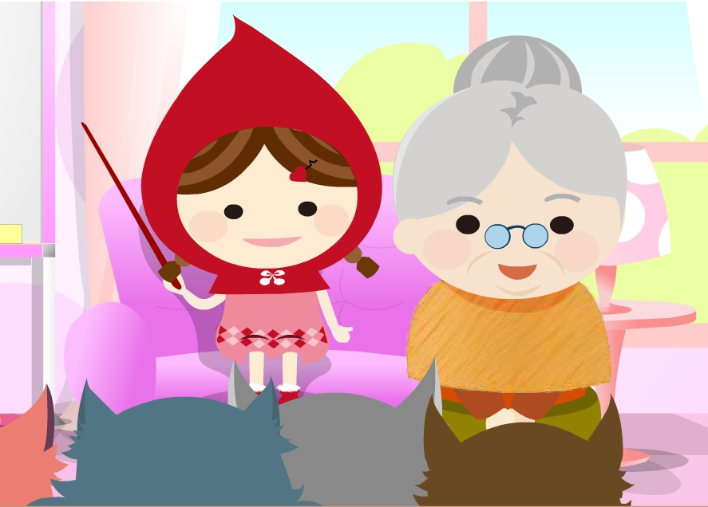
___ my _______.
She’s
grandma

Slide 9
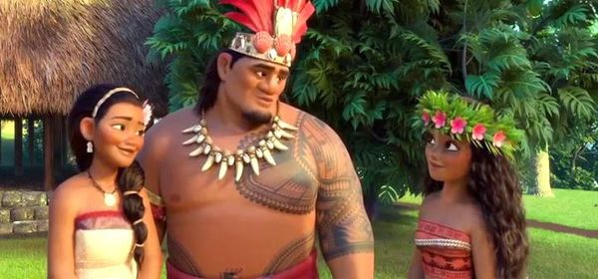
___ my _____.
He’s
father

Slide 10
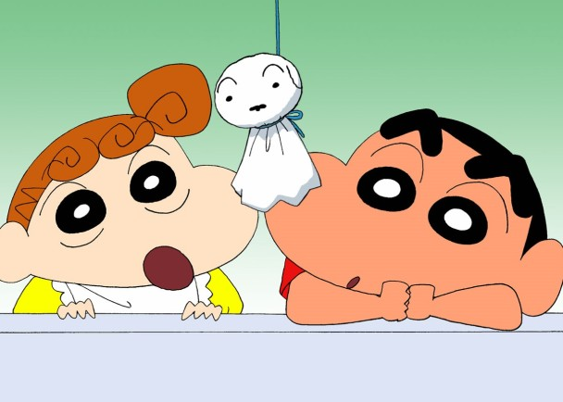
___ my ______.
He’s
brother

Slide 11
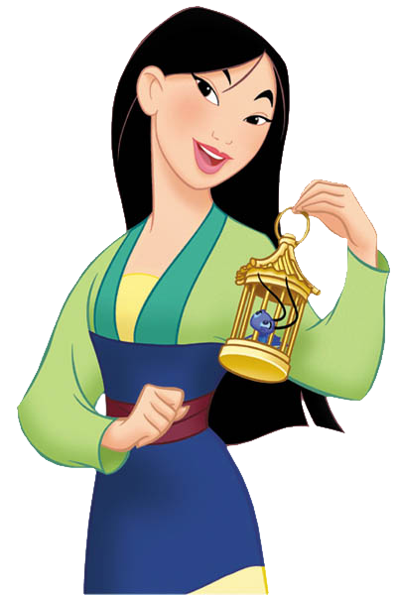
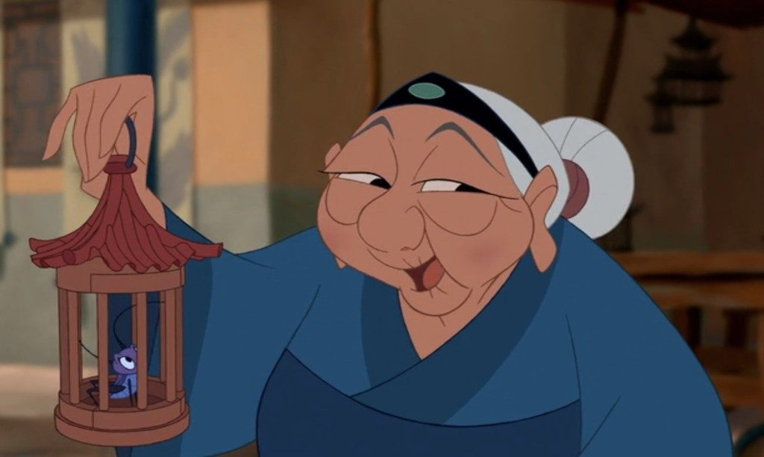
___ my _____.
She’s
grandma

Slide 12
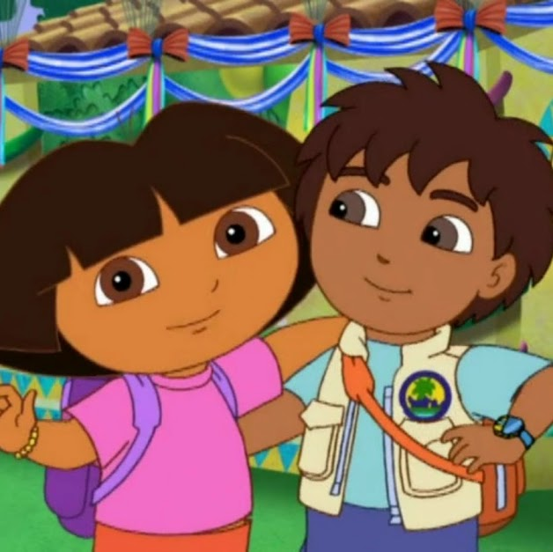
___ my _______.
She’s
sister

Slide 15
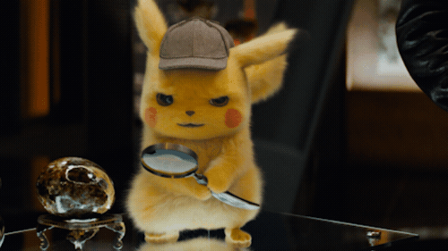
Find the contractions of the Verb TO BE.

Slide 16
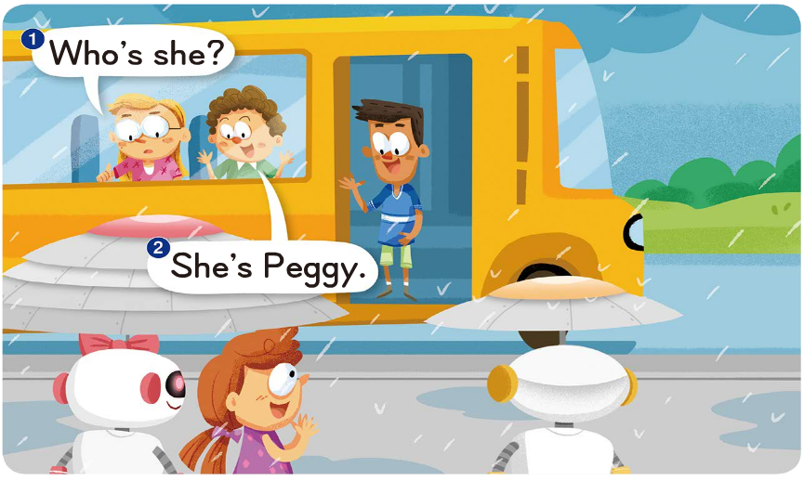
Who is
She is

Slide 17
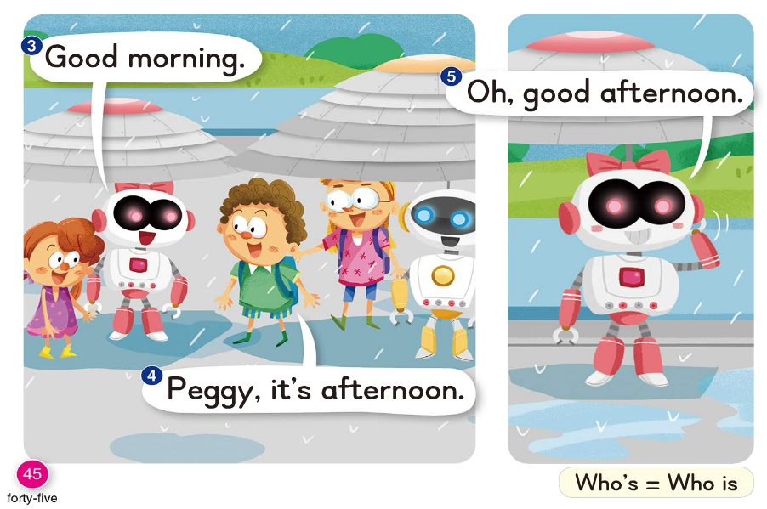
it is

Slide 18
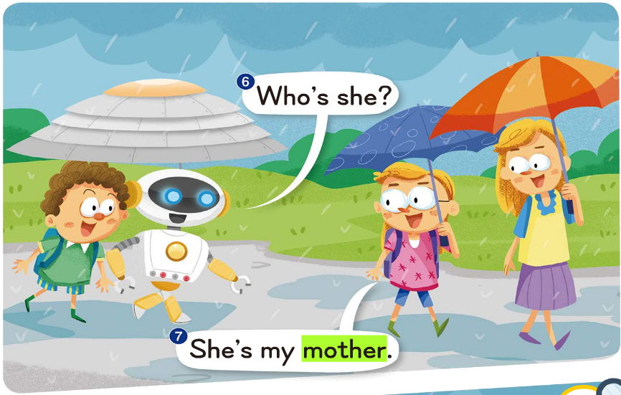
Who is
She is

Slide 19
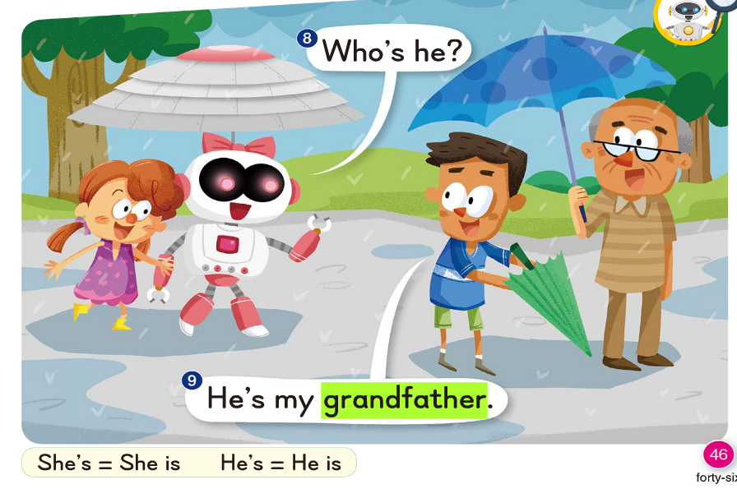
Who is
He is

Slide 20
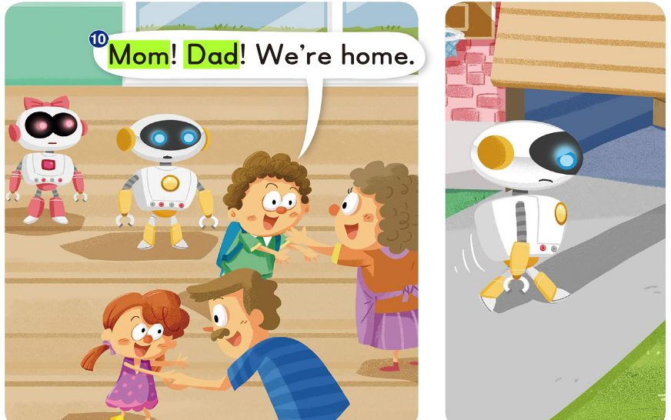
We are

Slide 21
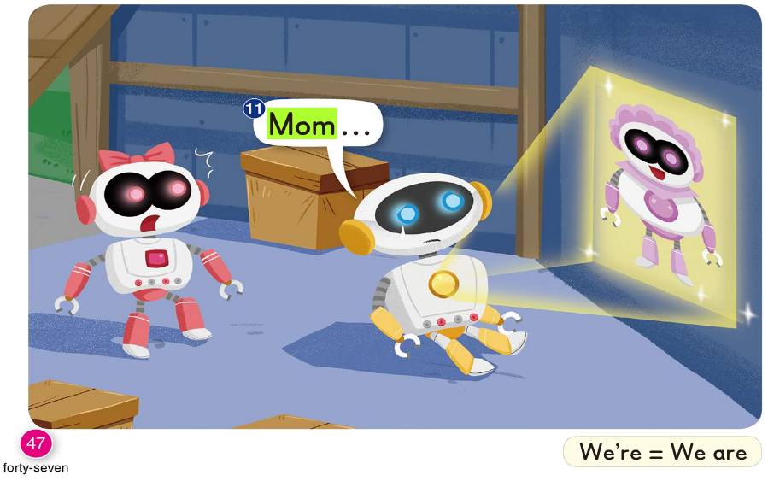

Slide 22
She is
She is
you are

Slide 24
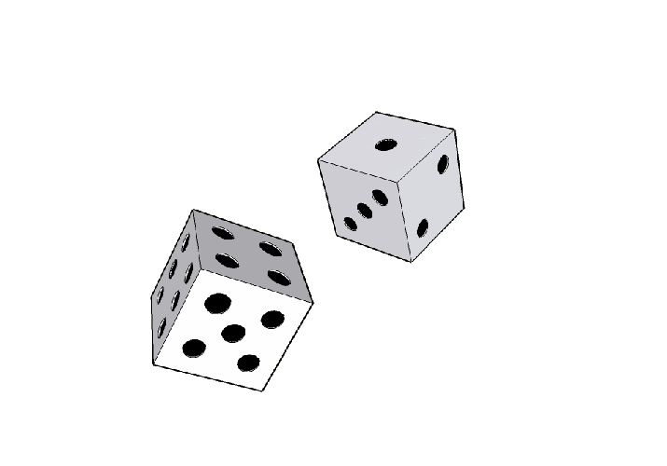
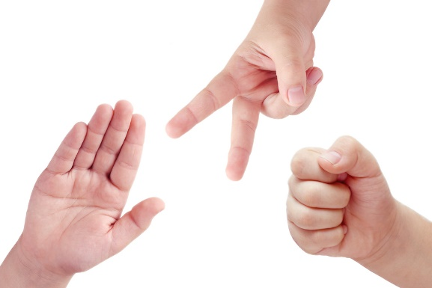
1 → Echo (last words for 3 times)
2 → Group 1/2/3 read
3 → Group 4/5/6 read
4 → Mandy reads (Find mistake)
5 → Every team gets 1 point.
6 →

